Slide 1
Multilabel Plant Disease Classification Using Deep learning
Settipalli Sai Teja
Advisor
Dr. Subhasish Dhal

Slide 2
AGENDA
Introduction
Approach
Models
Dataset
Training
Results
Conclusion

Slide 3
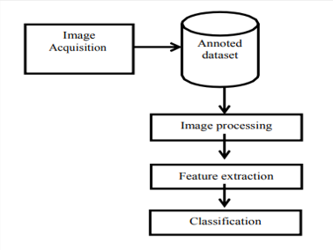
Introduction
Plant disease Classification is done by taking the Leaf images of the infected plant and then using the patterns formed on this leaf to make the prediction. In essence it is a image classification problem.
In the current day there are two approaches for an image classification problem. The traditional machine learning approach or the deep learning based approach.
Machine Learning based approach requires manual feature extraction which involves utilising multiple filters to process the image. These extracted features are then used to train machine learning models like SVM for classification.
The Deep Learning based approach provides an end to end solution as the Convolution part of the model is capable of extracting features from the image and the Fully connected layers are capable of making the Classification.
Deep Learning models also have better performance in classifying the data provided to them along with added comfort of being in an all in one system.

Slide 4
Approach
Based on many of the works in the field of image classification it clear that Deep Learning based approach is more favorable in comparison to the Machine Learning based approach both in terms of ease of implementation and performance.
Among the Deep learning models Transfer Learning based models seem to have an edge in terms of performance while utilizing lower computational resources.
Transfer learning is a Machine learning methodology where a model developed for a certain task is re-purposed on a second related task. Transfer learning provides an optimization technique that allows rapid progress or improved performance when modeling the second task.
The amount of time and computational power required to train custom deep learning models on large image data sets is really high and utilizing transfer learning cuts it down by a large margin.
The ImageNet project is a large visual database which contains nearly 14 million annotated images belonging to nearly 20000 classes.
AlexNet, VGG series, DenseNet series, ResNet series, Inception Series, AmoebaNet, MobileNet, Xception, EfficientNet are some of the well know Image classification Architectures.

Slide 5
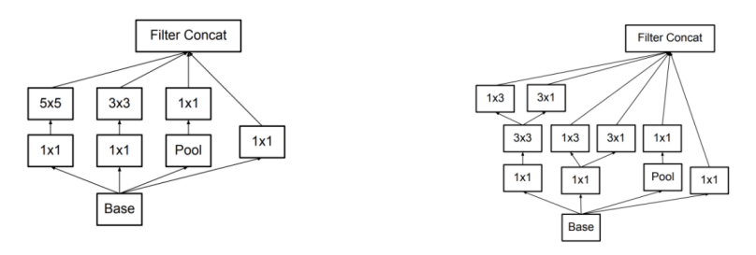
Inception V3
In the inception models instead of having deep layers, we have parallel layers thus making our model wider rather than making it deeper.
The Inception V1 model had convolutional layers of size 1x1,3x3,5x5,3x3 running in parallel but the 5x5 convolution layer was computationally pretty expensive.
In Inception V3 larger Convolutions in the model were factorized into smaller Convolutions. To further improve the model spatial factorization into asymmetrical convolution was also followed.
To reduce the computational cost the 5×5 convolutional layer was replaced by two 3×3 convolutional layers and 3x3 convolution layers were replaced by 1x3 layer followed by 3x1 layer.
These changes along with Auxiliary classifier to improve the convergence of very deep neural networks and efficient grid sizing for dimensionality reduction further improved the model.

Slide 6
Xception
Xception stands for “extreme inception”, it takes the principles of Inception to an extreme. The Xception model also has multiple convolution layers running in parallel just like in the case of Inception.
In Inception, 1x1 convolutions were used to compress the original input, and from each of those input spaces we used different type of filters on each of the depth space. Xception just reverses this step. Instead, it first applies the filters on each of the depth map and then finally compresses the input space using 1X1 convolution by applying it across the depth.
There is one more difference between Inception and Xception. Xception doesn’t introduce any non-linearity while Inception does.
Xception tells us that with both Depth wise Separable Convolution and Residual Connections, it really helps to improve the accuracy..
Xception is claimed to have similar model size with Inception V3 and requires slightly more computation than Inception V3.
It was also observed both Inception and Xception performed better than the models of their time like VGGNet and ResNet.

Slide 7
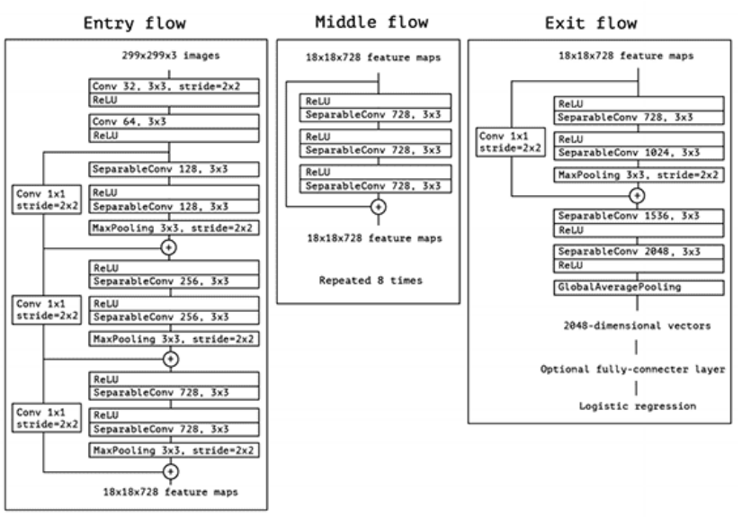

Slide 8
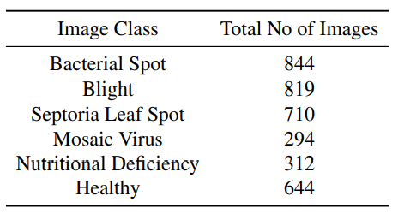
Dataset
Custom Dataset with 3274 leaf images of tomato plant.
Images were segregated into 6 classes namely Bacterial Spot, Blight, Septoria Leaf Spot, Mosaic Virus, Nutritional Deficiency, Healthy.
It was ensured that only a portion of the images were multi labeled so that the model does not become biased to make multi label predictions all the time.
All the images were reshaped to the same size of (256,256,3) as CNN models need images to be of the same size.
One hot encoding of the labels was done both for ease of use and to facilitate multi label classification.
The entire data set was then split into training set (70%), validation set (15%) and testing set (15%).

Slide 9
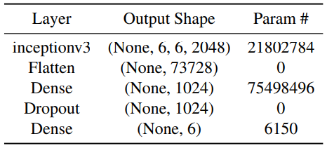
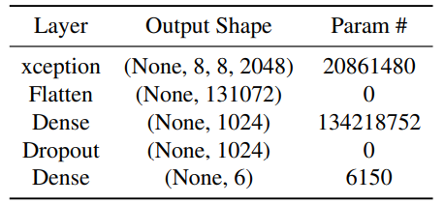
Training
From the Original Transfer Learning models we have retained the entire architecture except the last layer as it specific to ImageNet data.
Added a flatten layer to smoothen the output of the model, A FC layer with 1024 nodes with ReLu activation followed by a drop out layer with a drop out factor of 0.3
Final FC layer with 6 nodes corresponding to the total no of classes with sigmoid activation for the classification.
We have utilized binary cross entropy loss with Adam optimizer as the labels were one hot encoded.
The model was trained for 10 epochs with a batch size of 32 to optimize both accuracy and computation
Experimented with other values for no of nodes in first FC layer, Drop out factor and batch size but and found these values to give the best result.
Inception V3 Architecture
Xception V3 Architecture

Slide 10
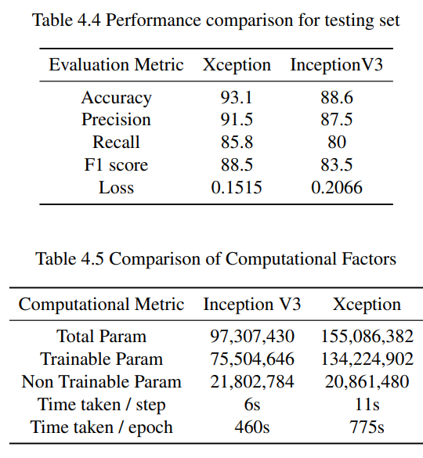
Results
The Inception V3 model had a training accuracy of 95% with a validation accuracy of 89%.
The model was finally evaluated on testing set yielding an accuracy of 88.6% with a loss of 0.2066
The Xception model had a training accuracy of 97.3% and a validation accuracy of 93.5%.
On evaluating the model on the testing set, obtained an accuracy of 93.1% with a loss of 0.1515.
Inception V3 model took an average of 460s per epoch while Xception Model took an average of 775s per epoch.
The difference in training and validation accuracy is quite less so there is little to no overfitting in either of the models
The difference in validation and test accuracy is marginal hence making the model usable.

Slide 11
Confusion Matrices
Bacterial Spot
371 | 19
12 | 92
Blight
350 | 12
8 | 122
Bacterial Spot
377 | 11
20 | 84
Blight
331 | 31
12 | 118
Mosaic Virus
436 | 4
0 | 54
Nutritional Def
434 | 3
42 | 13
Mosaic Virus
437 | 1
10 | 44
Nutritional Def
433 | 4
42 | 13
Septoria Leaf Spot
388 | 6
14 | 84
Healthy
377 | 4
2 | 109
Septoria Leaf Spot
383 | 11
25 | 73
Healthy
376 | 5
2 | 109
Xception Model
Inception V3 Model

Slide 12
Conclusion
Both Inception V3 and Xception Models give sufficiently good results when it comes to accuracy with Xception performing slightly better than Inception based Model.
The Xception model requires more computation than Inception V3 model but the difference is quite low and hence Xception model is preferred.
Other transfer learning models requiring significantly higher computation are also available and they can be used if accuracy is the only determining factor. Such models would give a marginal improvement in performance with greatly heightened computation cost.
Our model is currently constrained by the number of samples available and having a much larger dataset might help improve the accuracy.
We believe the accuracy obtained for the Multi Label Disease Classification model for tomato data set is satisfactory and thus it would safe to say that this approach can also be utilized for other plant diseases as well.

Slide 13
THANK YOU
Settipalli Sai Teja
1901180
settipalli.teja@iiitg.ac.in

